Slide 1

Cookies for Uvalde

Slide 2
The Wedding Cookie Table Community, a Facebook community, stepped up to provide relief and comfort to the people of Uvalde, Texas, who are forever in our hearts.

Slide 3
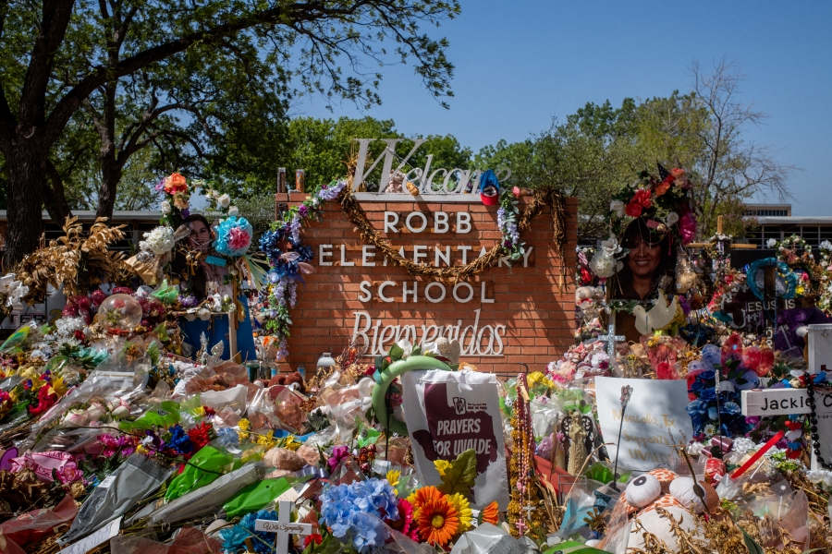
.

Slide 4
We didn’t know we were embarking on a monumental project that would touch the lives of hundreds of people. They received a “lift up” through our Community’s caring and cookies.

Slide 5
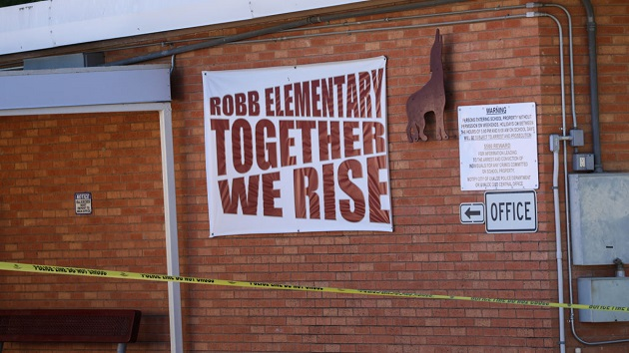
.

Slide 6
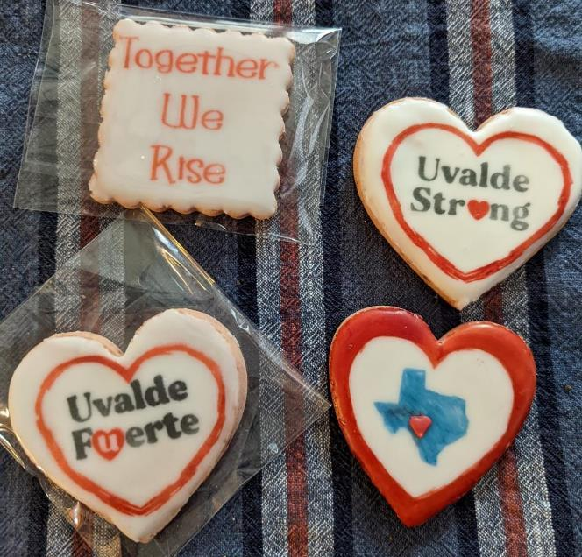
.
.

Slide 7
The Background

Slide 8
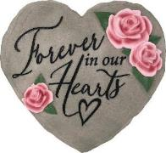
On May 24, 2022, an unspeakable tragedy occurred when the lives of 19 children and 2 adults were taken at the Robb Elementary School in Uvalde, Texas, a small rural community with
16,000 residents.

Slide 9
The victims were all in the same fourth-grade classroom. Fifteen of them were 10 years old; two were 9 and two were 11. The teachers were 44 and 48. They were likely all looking forward to free-time and summer vacation.

Slide 10
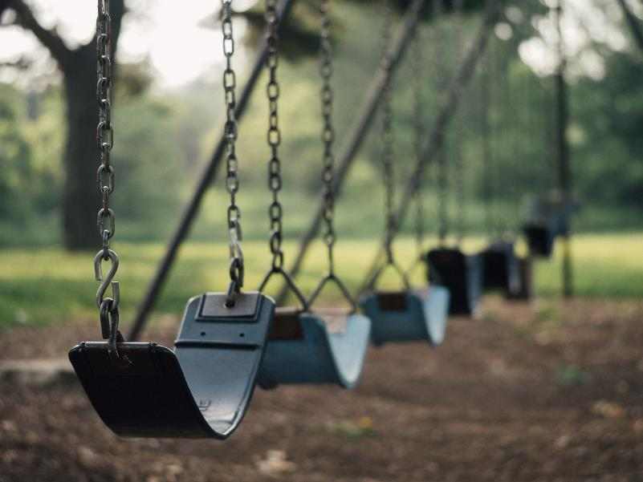

Slide 11
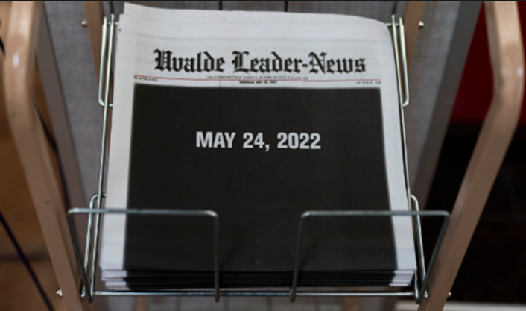
No words could or can describe the horror of what happened.

Slide 12
In response,
Wedding Cookie Table Community members came together to do what we do best…share love and goodness through our cookie table tradition with the Uvalde community.

Slide 13
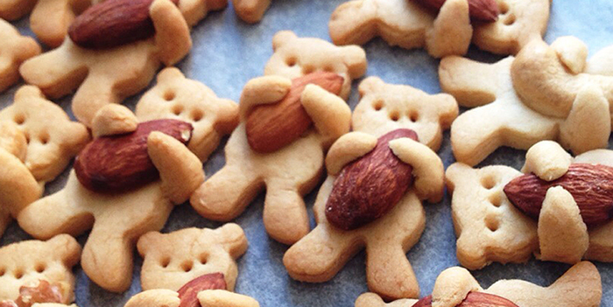

Slide 14
Step One: Research

Slide 15
A post on the WCTC indicated there was preliminary interest by members in undertaking a project for Uvalde.

Slide 16
Step one for our Texas team (based in San Antonio—about 1.5 hours from Uvalde) was to get the lay of the land, confirm that the Uvalde community would be receptive, determine where we might hold an event, etc.

Slide 17
Judi Coulter-Salazar is a San Antonio-based WCTC member. She and her husband Carlos drove to Uvalde to do research, all the while keeping us closely apprised of their findings with photos and videos. Judi has roots in Uniontown, PA, and is fully versed in the cookie table tradition.

Slide 18
For their second trip to Uvalde, Judi and Carlos invited another couple from San Antonio to go with them: Janet and Mike Treemarki. Both couples attended the same church but didn’t know each other before this project started.

Slide 19
Judi and Janet are both WCTC members. The husbands were drafted onto the team and we were happy to have them. Both
Carlos and Mike made tremendous contributions to this project.

Slide 20
In addition to Judi’s Southwestern PA roots, Janet and Mike Treemarki are WCTC team members also with Pittsburgh-area roots:
Aliquippa and McKees Rocks.
Nice….

Slide 21
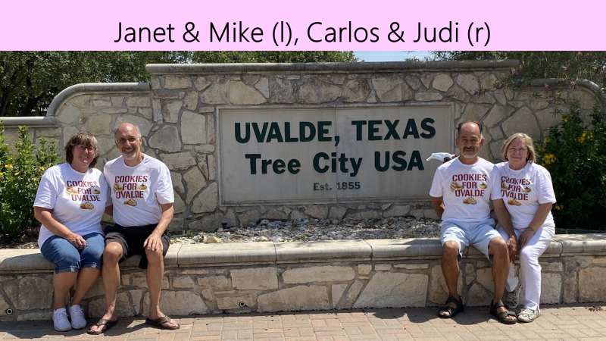

Slide 22
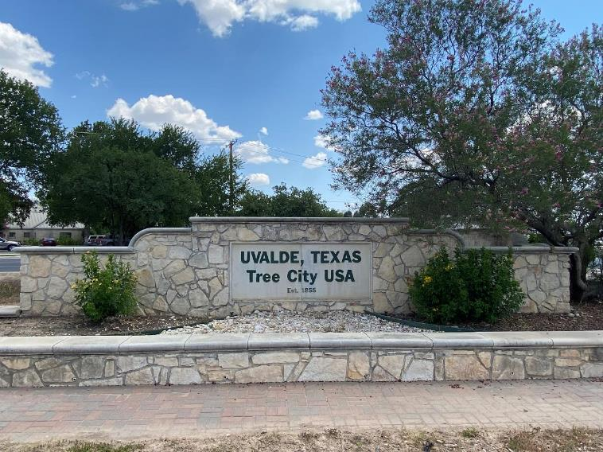

Slide 23
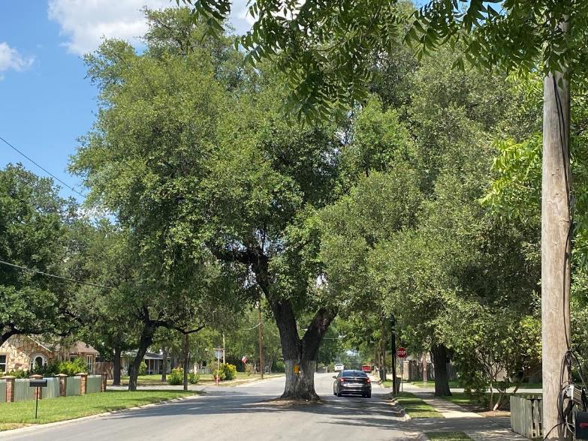

Slide 24
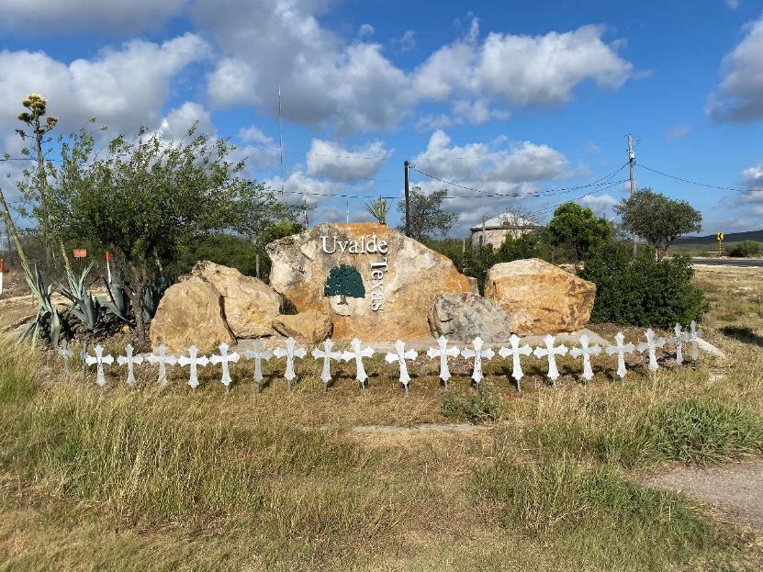

Slide 25
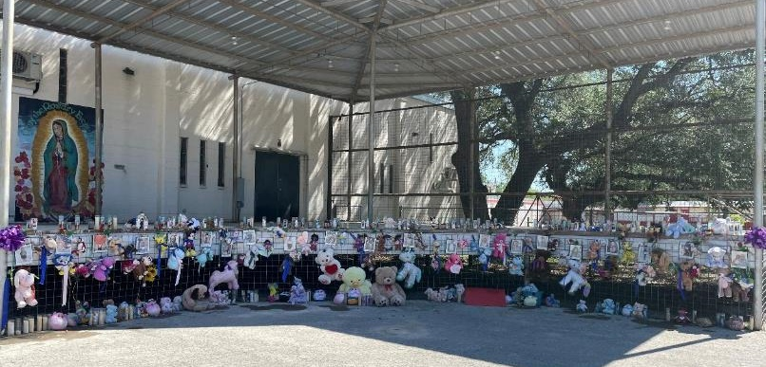

Slide 26
Sacred Heart Church where many of the shooting victims’ funerals were held was receptive to letting us have use of their banquet hall for a community event.

Slide 27
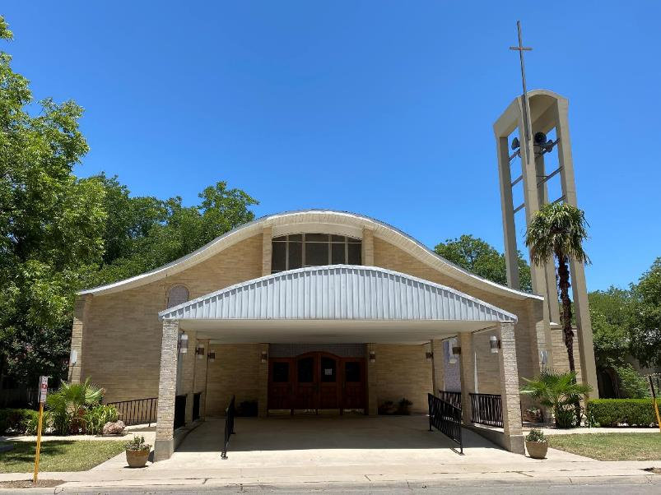

Slide 28
Always resourceful, until Judi could get into the banquet hall on a weekday, she took photos through the window so we could see what it looked like. Anxious to order supplies, we tried guessing the table length for linens based on the photo.

Slide 29
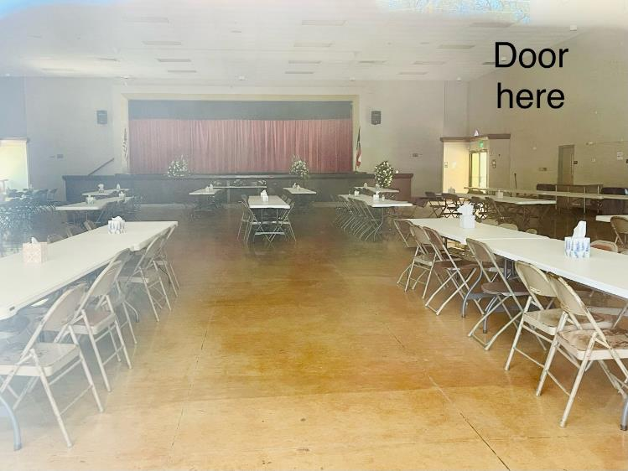
What length would you have guessed?

Slide 30
They are actually 8 foot tables. ☺

Slide 31
Step Two: Develop a Plan

Slide 32
Our Mission:
Let the people of Uvalde know that we and others care about them.

Slide 33
Our Attitude:
“There is no ‘I’ in team”. We work collaboratively.

Slide 34
Location of our Members:
Geographically-dispersed across the continental U.S.

Slide 35
Our Knowledge of Others on the Team:
Limited.
Most have never met face-to-face.

Slide 36
But with shared values centered around baking, kindness and generosity, many of us have an inexplicable trust and
belief in each other.

Slide 37
Our Funding:
Self-Financed

Slide 38
Launch Date:
May 31, 2022
Set-Up Date:
June 25, 2022
Event Dates:
June 26 & June 27, 2022

Slide 39
Strategic Tool:
Cookies

Slide 40
Our Mode of Team Interaction:
Primarily Remote Activities

Slide 41
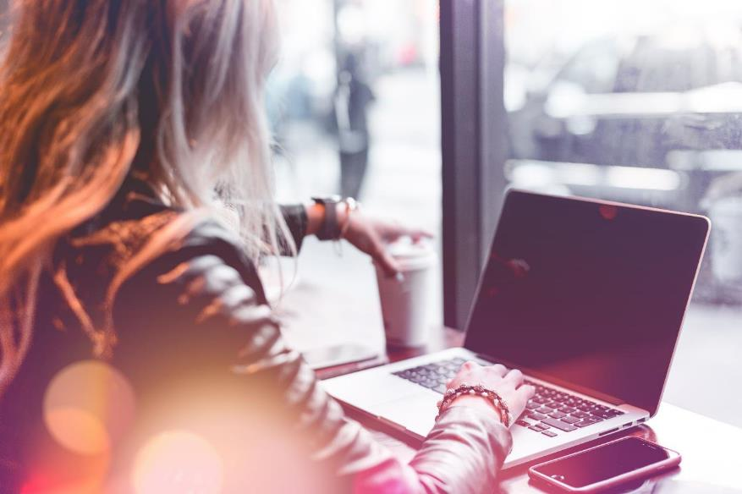

Slide 42
Goal: Provide Comfort through Cookies
1. Uvalde Community
(estimated attendance 750)
2. Uvalde Memorial Hospital
(500+ employees)
3. The Helpers & Service-Providers
who provided community support
throughout this tragedy

Slide 43
We asked our members to provide 800 dozen cookies and you came through with 1,400 dozen.
Most were shipped via USPS, Fed Ex and UPS.

Slide 44

Those on this mission were strategic, cohesive, coordinated and focused solely on the people of Uvalde.

Slide 45
Various teams formed and worked behind the scenes to: develop an overall plan; manage logistics; track cookie table items, cookies and gift shipments; recruit and train volunteers; plan the schedule and deploy resources for June 25, 26 & 27.

Slide 46
While our Facebook group is called “The Wedding Cookie Table Community” because weddings have the largest and most elaborate displays….

Slide 47
…Cookie tables often mark many life events, both happy and sad. Cookies can provide comfort and promote healing at difficult times.
It was critical that this table be dignified and respectful to honor the victims.

Slide 48
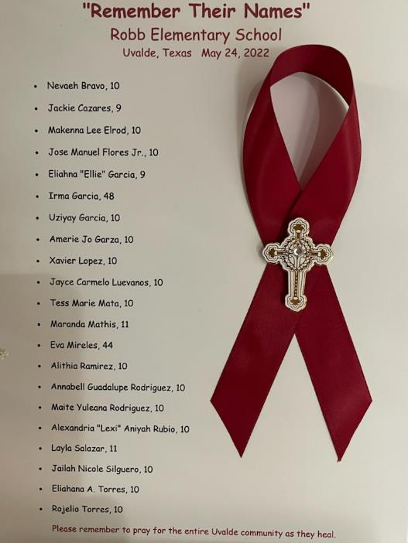

Slide 49
After considering many options, our member, Mona D’Ambrosia, who plans events professionally, advised us to design an understated table that would highlight the cookies, reflecting the innocence of children with white linens, fresh white flowers and twenty-one silk, rose-petal bears, each to represent a lost soul.

Slide 50
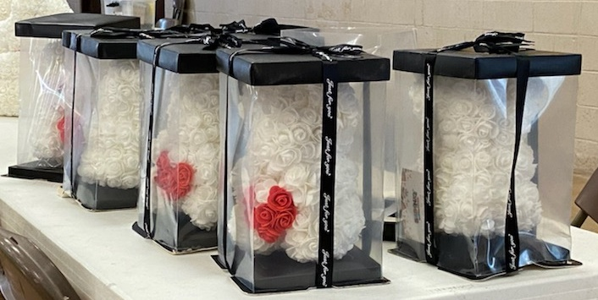

Slide 51
We consulted with member Angie Vera who is familiar with local culture asking if it was fitting to put the names of the victims on the individual bears. Angie believed it was very fitting to include names since many local memorials have names of victim on them.

Slide 52
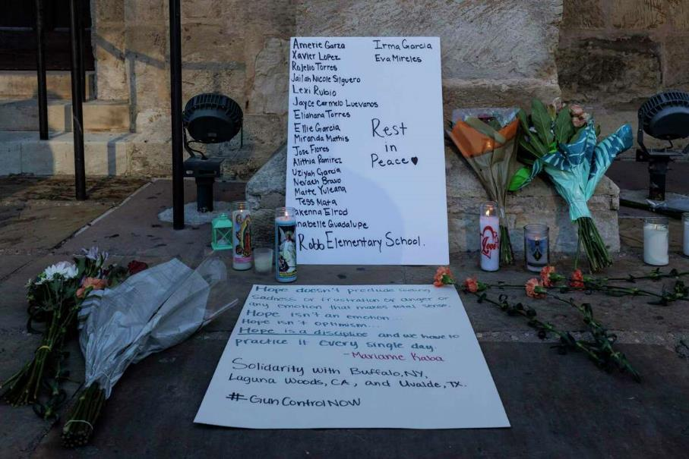

Slide 53
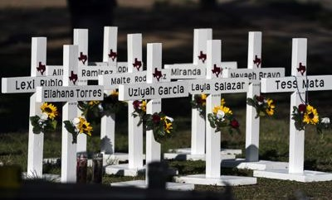

Slide 54
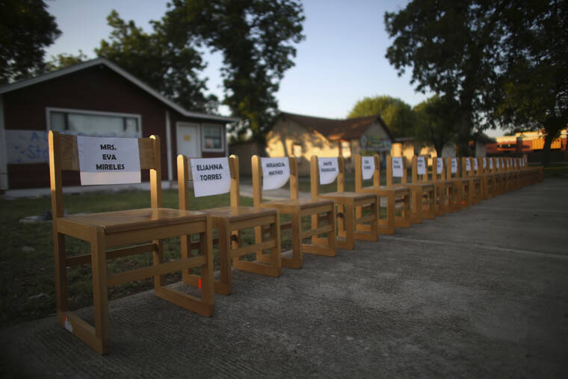

Slide 55
Karen Sica Radu, a very talented member from the Pittsburgh-area, spent a lot of time thinking about the best way to attach the names to the bears. She lovingly embroidered the names of each of the two teachers and nineteen children.

Slide 56
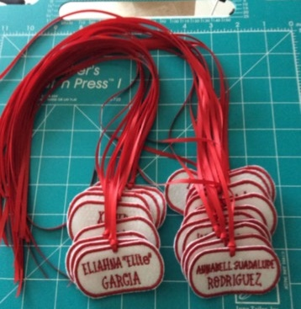

Slide 57
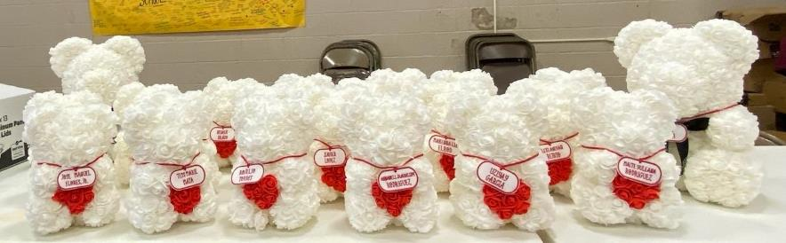

Slide 58
The WCTC wanted to comfort Uvalde children with “Jellycat” stuffed animals which are known to provide comfort to grieving young people and adults as sensory items that are incredibly soft.

Slide 59
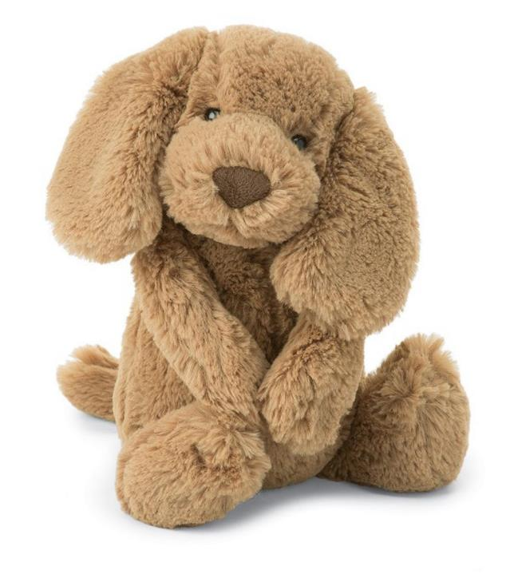

Slide 60
Our member, Laraine Churchel Schultz, has incredibly giving friends who have the shop “Mica and Molly’s” in West Melbourne, FL. Mica and Molly are sisters who let us purchase Jellycats at cost, and generously shipped the Jellycats to Uvalde at their own expense.

Slide 61
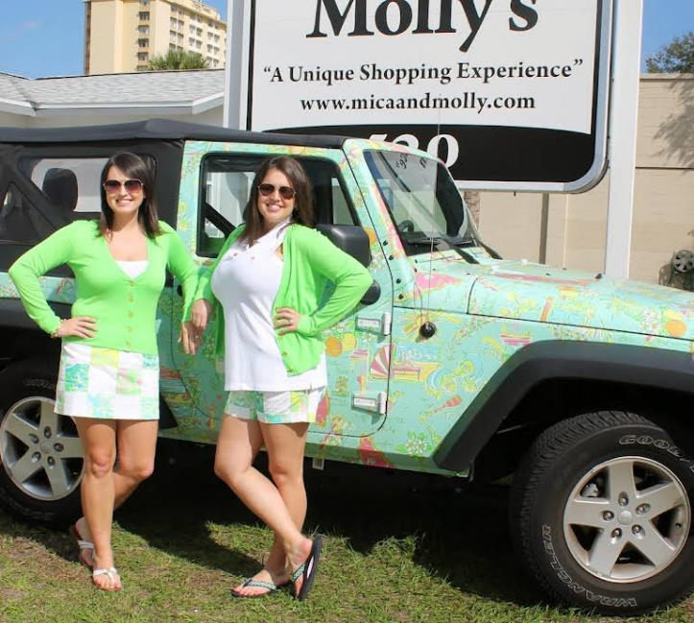
Thank you, Mica
and Molly

Slide 62
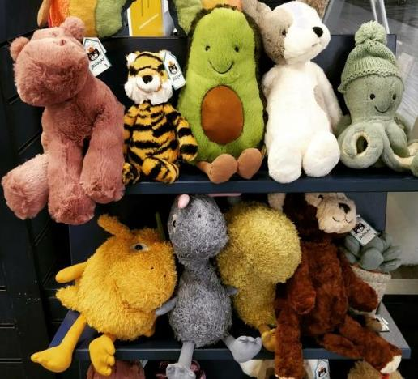
We asked for 400 Jellycats and our generous members sent 500.

Slide 63
We wanted to provide copies of a resource book that helps people to cope with grieving. We asked for 100 copies of the book “Tear Soup” and you, our generous members, sent 150 copies, some in English and some in Spanish.

Slide 64
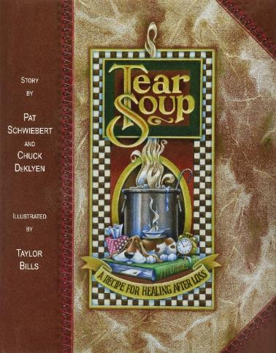


Slide 65
We asked for embroidered aprons for our volunteers to wear at the event and you took care of that matter in minutes.

Slide 66
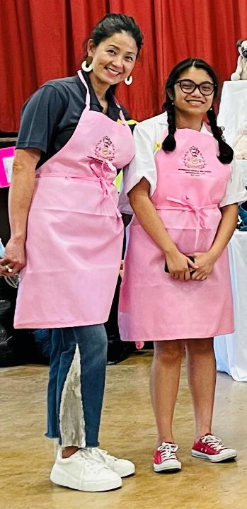

Slide 67
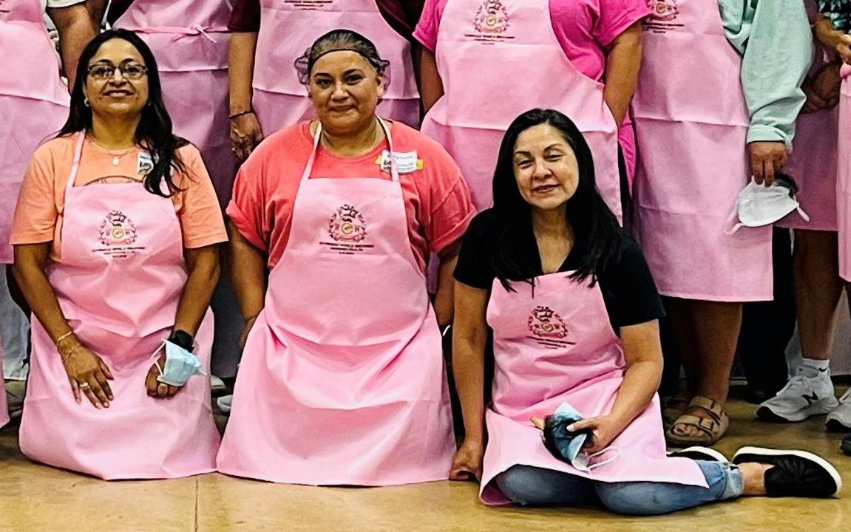

Slide 68
We asked for handwritten notes for the Uvalde community and the
WCTC community came through again.

Slide 69
WCTC members even sent notes and created posts to encourage our own volunteers

Slide 70
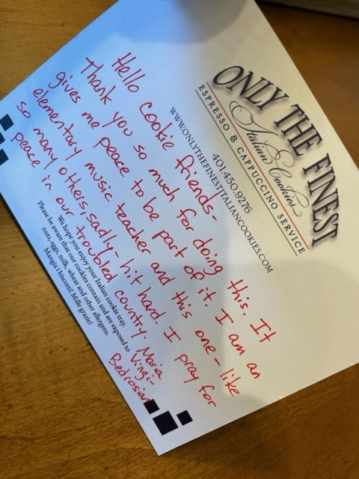

Slide 71
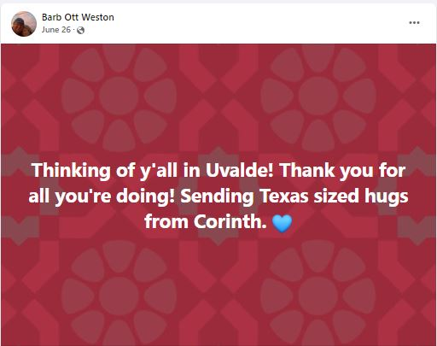

Slide 72
Adults and children created messages and artwork for the Uvalde community.

Slide 73
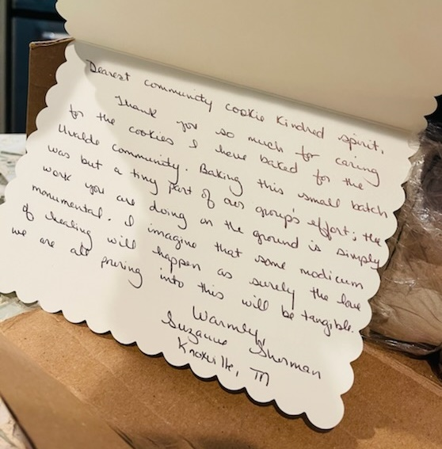

Slide 74
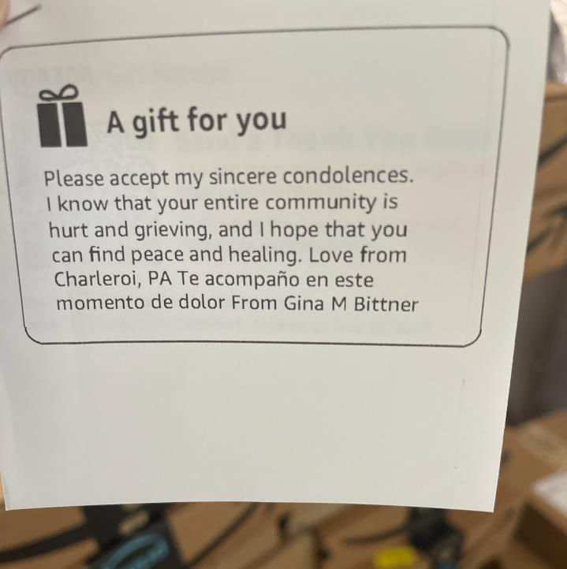

Slide 75
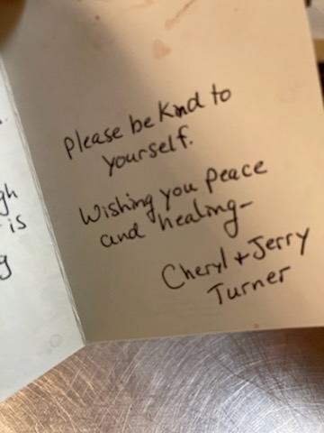

Slide 76
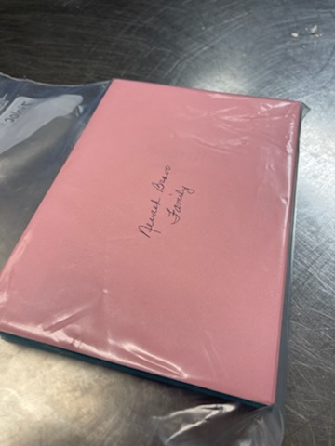

Slide 77
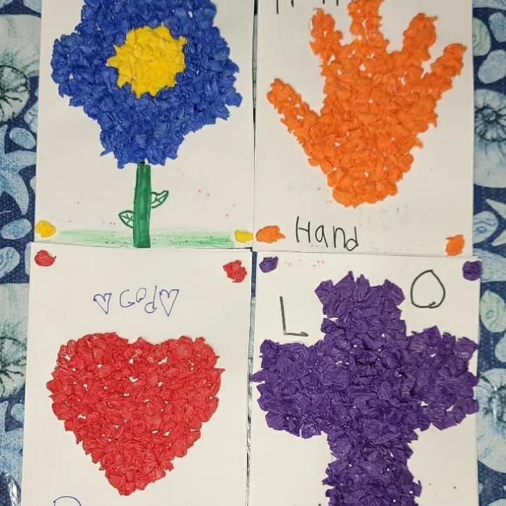

Slide 78
All of the table and gift items we needed were generously purchased by WCTC members and tracked by our dedicated and capable volunteers who worked tirelessly behind the scenes.

Slide 79
Ellen Colhouer, “Contessa Marie”, took the lead on table design and decision-making on items needed for the cookie tables and events.

Slide 80
Ellen made selections and communicated to
Venus Czernics, “Vee Cz”, who created and monitored our “wish lists”.

Slide 81
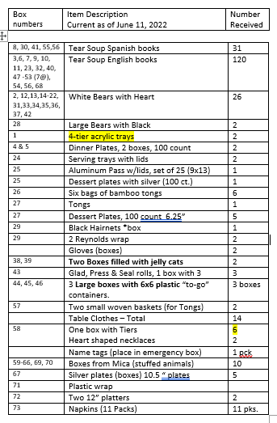

Slide 82
No details were left to chance. The centerpiece of a cookie table is, of course, the cookies.

Slide 83
Our generous and supportive WCTC members embraced the project instantly. We were united in wanting this endeavor to succeed to support Uvalde. WCTC members went to work.

Slide 84
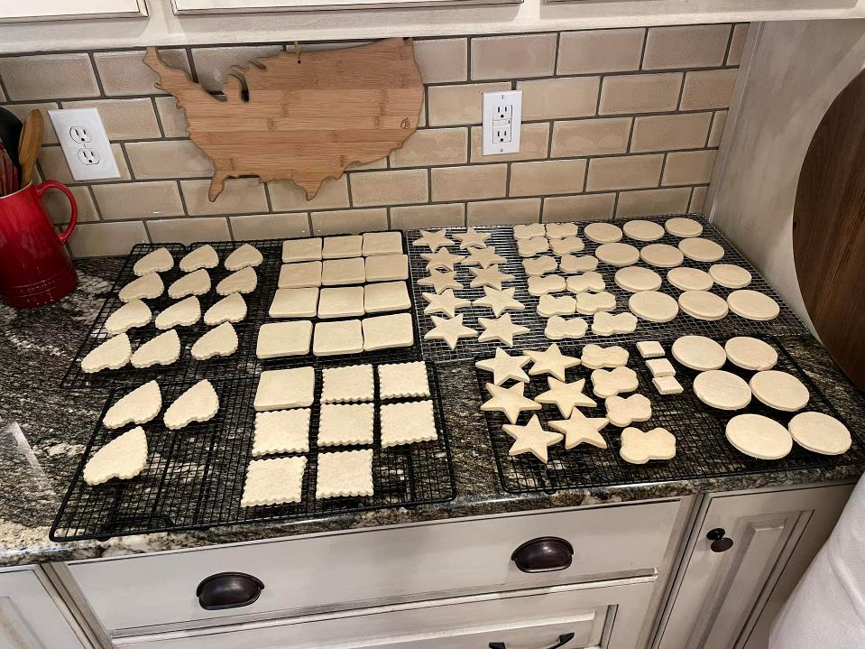

Slide 85
Cookies that were shipped by members were carefully logged and tracked and recorded upon arrival by
Judi Coulter-Salazar.

Slide 86
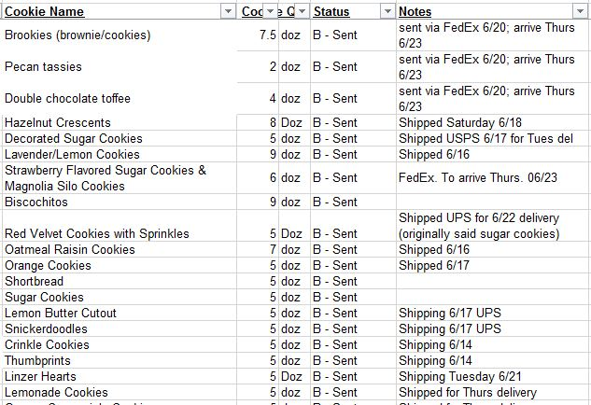

Slide 87
Judi lived and breathed the Uvalde project from conception to completion.

Slide 88
WCTC members closely monitored tracking information on cookie shipments and kept the community informed.

Slide 89
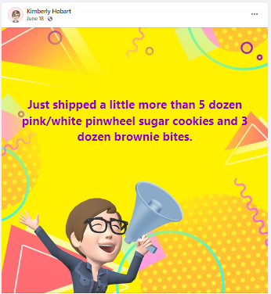

Slide 90
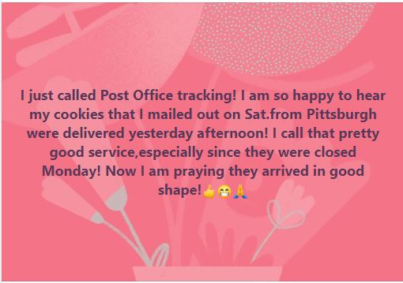

Slide 91
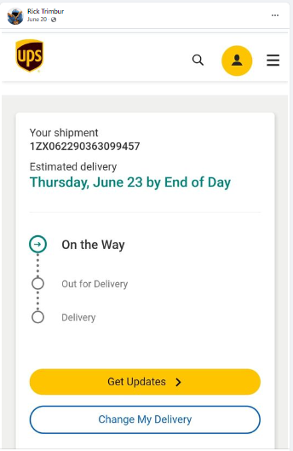

Slide 92
The first box of cookies arrived from Iowa on Wednesday, June 15 and the rest was history. Cookies poured in each day for about ten days.

Slide 93
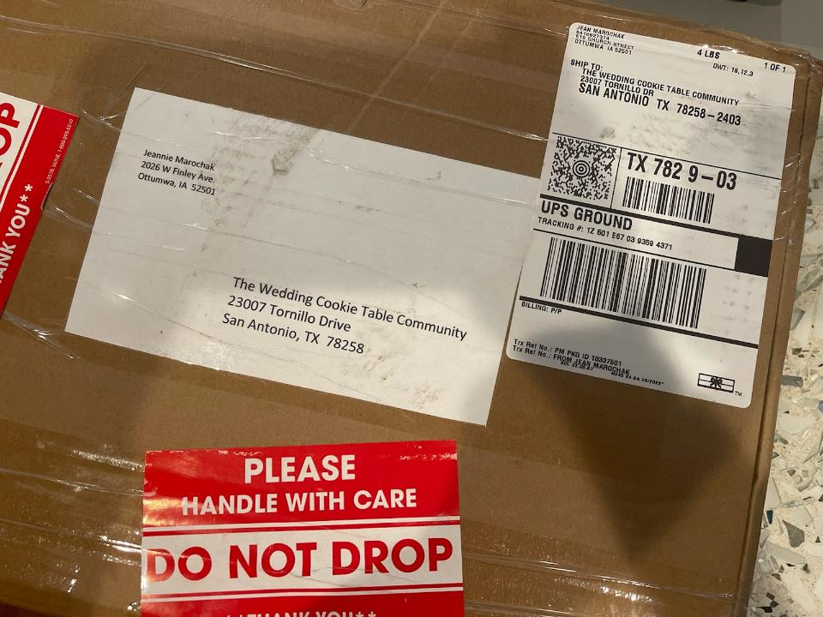

Slide 94
Most cookies arrived in excellent shape. A few “cookie crumbles” arrived. We bagged and offered them as “ice cream toppings” at our event. Some “toppings” were hand-delivered after the event along with whole cookies to residents of Uvalde who could not attend.

Slide 95
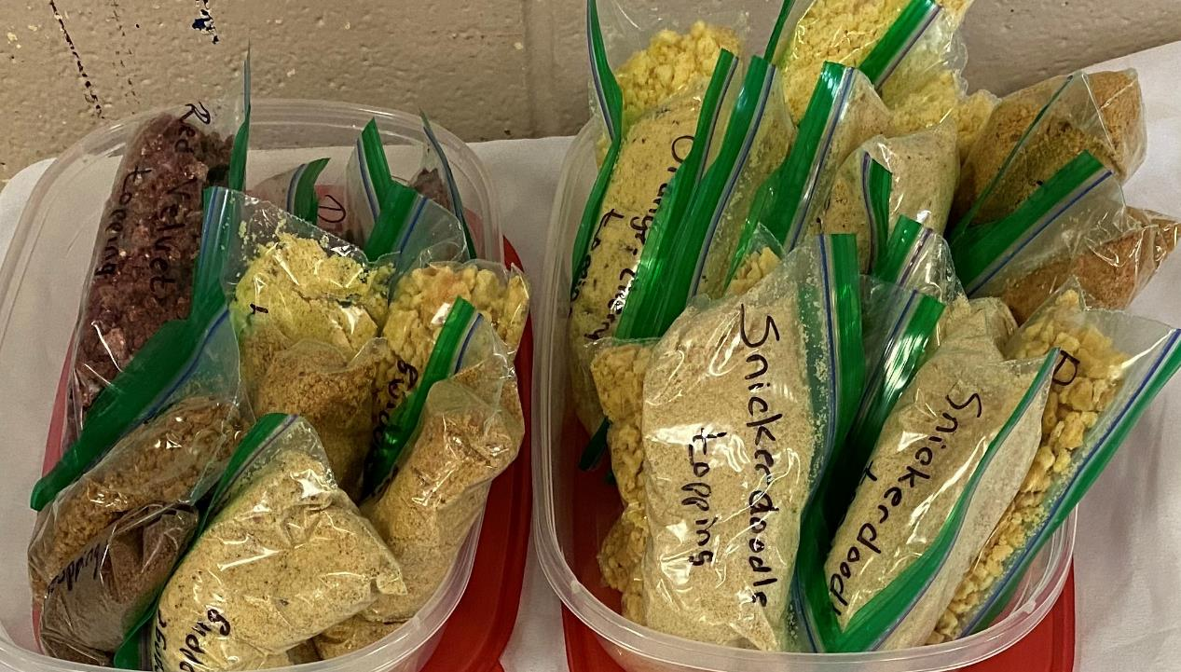

Slide 96
WCTC members not only share cookies, we share recipes and helpful pointers with each other

Slide 97
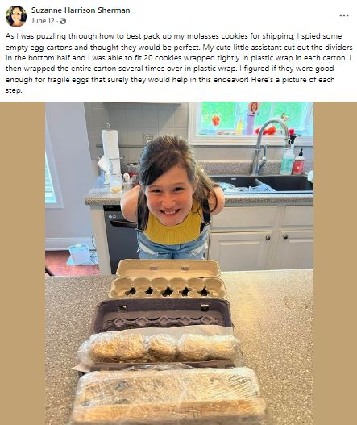

Slide 98
We asked for cookies that expressed love and support for Uvalde. As always, WCTC members came through, sending their very best. Here is a sampling of the 1,400 dozen cookies that arrived.

Slide 99
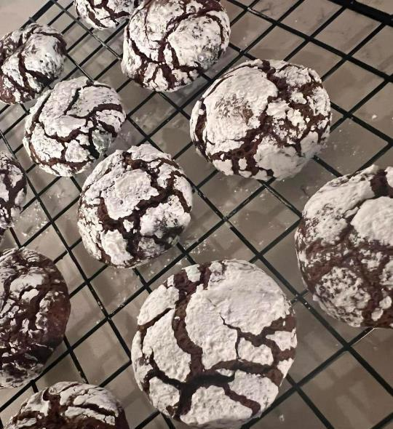

Slide 100
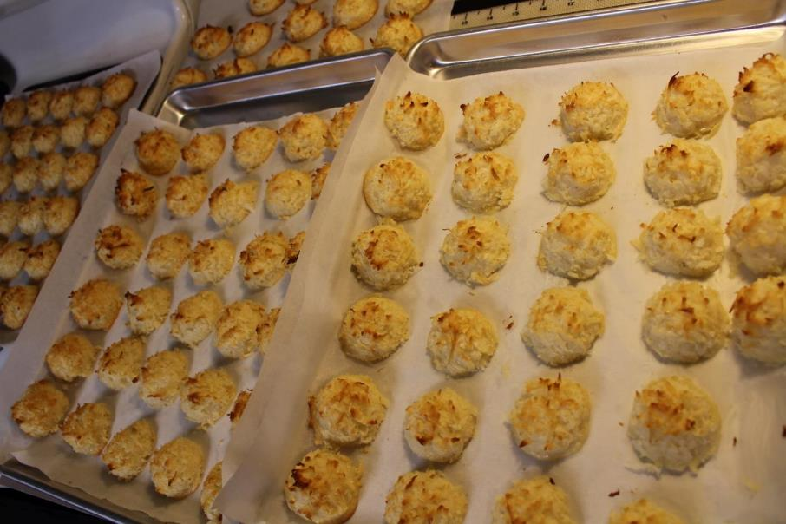

Slide 101
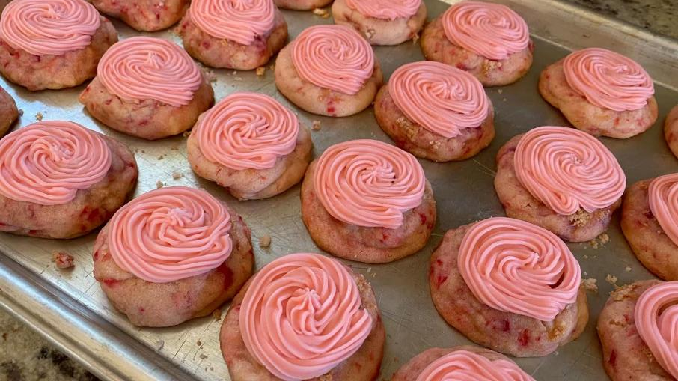

Slide 102
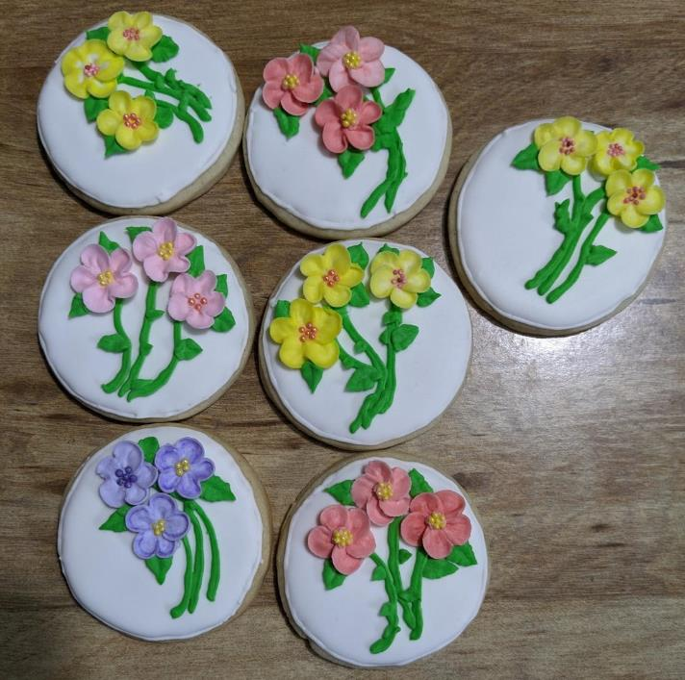

Slide 103
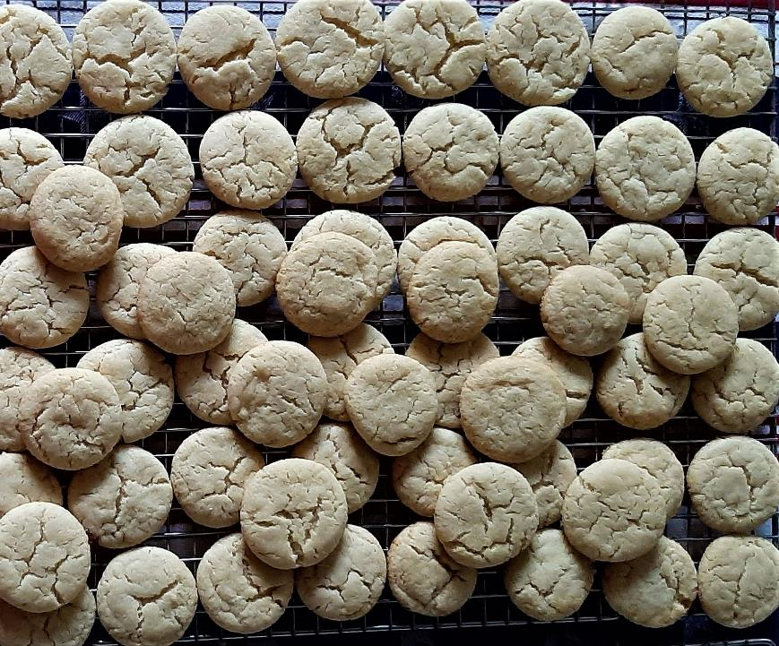

Slide 104
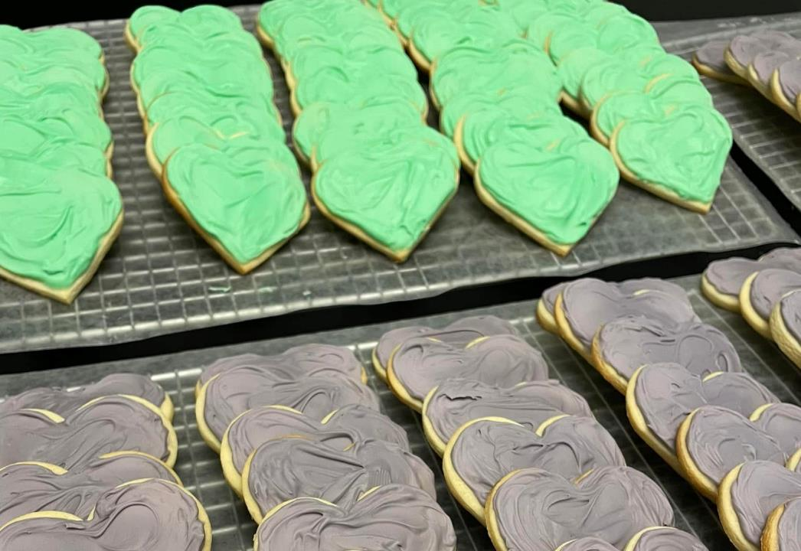

Slide 105


Slide 106


Slide 107


Slide 108


Slide 109


Slide 110


Slide 111


Slide 112


Slide 113


Slide 114


Slide 115


Slide 116


Slide 117


Slide 118


Slide 119


Slide 120


Slide 121


Slide 122


Slide 123


Slide 124


Slide 125


Slide 126


Slide 127


Slide 128


Slide 129


Slide 130


Slide 131


Slide 132


Slide 133


Slide 134


Slide 135


Slide 136



Slide 137


Slide 138


Slide 139


Slide 140


Slide 141


Slide 142


Slide 143


Slide 144


Slide 145


Slide 146


Slide 147


Slide 148


Slide 149
The cookies were nothing short of amazing.

Slide 150
The cookies were works of art, both beautiful and delicious. But as we know, in the WCTC family, our secret ingredient is always love.

Slide 151

Cookies arrived from 24 states and Washington, DC

Slide 152
WCTC members shipped cookies from about half of the U.S.

Slide 153
Packing the cookies properly was no small task and shipping them was no small expense as costs escalated with Covid.

Slide 154
Some members packed their own boxes and some relied on professional services like the UPS store employee who got the job done with great expertise and was in awe of this project.

Slide 155


Slide 156
Receiving the cookies and gift items was also no small task.

Slide 157
The delivery people became regulars at the door…part of the family…with dozens of boxes arriving each day.

Slide 158


Slide 159


Slide 160


Slide 161


Slide 162


Slide 163


Slide 164


Slide 165


Slide 166

Wi

Slide 167
A tremendous amount of planning and implementation went on in a short amount of time in the great state of Texas.

Slide 168
Meanwhile…back in Pittsburgh….

Slide 169
There are certain regional cookies that are only found in the Pittsburgh, PA area. We wanted them for Uvalde. Our cookie tables wouldn’t be complete without them. Some require refrigeration and delicate handling. It would be difficult for our members to ship them.

Slide 170
The group turned to member baker Christy Johnson Fullwood who has “Cookies & Candy by Christy”, asking her to accept orders for specialty cookies from our members who preferred to purchase cookies. WCTC members would purchase cookies by the dozen.
The price included shipping to TX.

Slide 171
The WCTC ordered a total of 325 dozen cookies from Christy: lady locks, Italian peaches, gobs, buckeyes, kolache/kiffles, pecan tassies and peanut butter blossoms.

Slide 172


Slide 173


Slide 174


Slide 175
It was difficult to determine the best way to get Christy’s cookies to Texas so they stayed cool and did not break in transit.

Slide 176
The budget allowed shipping the cookies to Texas, but we were worried about how they’d arrive. We agonized over this point and explored many options—perhaps the toughest decision of the entire project.

Slide 177
Christy was busy baking away while we pondered.

Slide 178


Slide 179


Slide 180
Christy offered to take time away from her business to drive our precious cookies in coolers with ice packs to Texas. She would fund the trip with money we would have spent on shipping and it would cover her travel expenses.

Slide 181

Decision Made. Our cookies were getting chauffeured to Texas.

Slide 182
Or something like that….

Slide 183
Christy had her car packed in West Pittsburg (near New Castle, PA, Lawrence County) at 5 a.m. on Tuesday, June 21.
Destination: the Lone Star State.

Slide 184


Slide 185
With our precious cargo, Christy was on Texas soil by close of business on Wednesday.

Slide 186


Slide 187
Christy put the cookies in the hands of two integral Texas team members: Janet and Mike Treemarki at 3p.m. on Wednesday, June 22. Judi gave her a sandwich and dessert and Christy was headed back to PA.

Slide 188


Slide 189
With full disclosure, Judi might have sent Christi home with a gift of a little more than a sandwich.

Slide 190


Slide 191
…Texas hospitality for
Christy’s husband who is a collector of fine spirits.
Thank you!

Slide 192

Christy went above and beyond and we are grateful.

Slide 193
Christy was back home by Thursday night at midnight.

Slide 194
Our “Pittsburgh” cookies then spent two nights in walk-in refrigeration at Holy Trinity in San Antonio, where Judi and Carlos and Janet and Mike are members.

Slide 195


We are grateful to these gentlemen who secured refrigerator and freezer space for our cookies at Holy Trinity: Brian Mylar, Grand Knight (L) and Deacon Ray Gonzales, Jr., Facility Manager (R).

Slide 196
As boxes of cookies arrived at Holy Trinity, they all had to be opened and sorted. And there were a plenty of cookies. Carlos and Mike did lots of organizing.

Slide 197


Slide 198
Saturday Prep Work
June 25, 2022

Slide 199
On the morning of Saturday, June 25, it was time to move all cookie table supplies, cookies and gifts to Uvalde. Judi and Carlos rented a Uhaul to transport items.

Slide 200


Slide 201


Slide 202
Several people joined the effort and volunteered to pack up items so the journey to Uvalde could begin.

Slide 203


Slide 204


Slide 205
The volunteers leaving from San Antonio met up with several Uvalde-based volunteers, including school teachers from Robb and Flores
Elementary Schools, both in Uvalde.

Slide 206
Saturday’s tasks included organizing cookies for the three separate projects and getting Sacred Heart set-up for Sunday.

Slide 207
Sacred Heart’s banquet hall does not have refrigeration needed for our cookies. The Texas team made arrangements to store cookies requiring refrigeration at
St. Philip’s Episcopal Church in Uvalde used for the community food pantry.

Slide 208

St. Philip’s Episcopal Church in Uvalde

Slide 209
Following are images of the set-up work done on Saturday to prepare for Sunday’s community cookie table event at Sacred Heart.

Slide 210


Slide 211


Slide 212


Slide 213


Slide 214


Slide 215


Slide 216


Slide 217


Slide 218


Slide 219


Slide 220


Slide 221


Slide 222


Slide 223


Slide 224


Slide 225


Slide 226


Slide 227
This is a fifth grade teacher, Brittany Quinones, a teacher at Flores Elementary in Uvalde who volunteered to help us. After the event, she delivered cookies for us to Robb and Flores
Elementary teachers.

Slide 228


Slide 229
Ms. Quinones told us about recent training Uvalde teachers received to help the children when they return to school.

Slide 230
She explained the initiative that focuses on meeting the social and emotional needs of students, asking them to talk about something positive that has happened recently with teachers being trained on how to cheer up students as needed.

Slide 231


Slide 232
We thank Ms. Quinones and the other teachers who gave of their time as volunteers to help our community event. Here are photos of additional volunteers and event set-up.

Slide 233


Slide 234


Slide 235


Slide 236


Slide 237

Janet, Judi and Lynn take a breath after a long day of set-up.

Slide 238
Janet Treemarki holds the sign that will be displayed explaining the cookie table tradition, a new tradition for many in Uvalde.

Slide 239


Slide 240
Cookies were trayed at
Sacred Heart. Those requiring refrigeration were shuttled to
St. Philip’s Episcopal where they were stored. The temperature in Uvalde reached a high of 104° on Saturday and we needed to safeguard the cookies.

Slide 241
Volunteers separated and trayed the 1,400 dozen cookies for the Sunday Community event, Monday’s Uvalde Memorial Hospital cookie table and Monday’s deliveries around Uvalde.

Slide 242
Another community event had been held in Uvalde after the tragedy. We used it as a gauge. It was a two-day event featuring prepared foods and it attracted 1,000 people over the course of a two-day weekend event.

Slide 243
With Sunday, June 26 being an open-community event, we opted to prepare for up to 750 people to attend. It was time to see how well we did with our calculations. With a cookie table, we never want to run short on cookies.

Slide 244
The local newspaper, the Uvalde Leader-News, published two advance stories on the WCTC’s community event.

Slide 245




Slide 246
The City of Uvalde, The Uvalde of Chamber and others posted our event on their websites. Sacred Heart Church put a notice in their Sunday bulletin. We did our best to spread the word.

Slide 247


Slide 248
We had an outstanding team of volunteers in place who labored all day Saturday to get things ready for Sunday’s Community event.

Slide 249


Slide 250
A toast to hosting
“a peach” of a great event for the
Uvalde community..

Slide 251


Slide 252
Plans were made. The community was invited. It was time to see how our
“cookie table” event would be received.

Slide 253
Sunday’s Cookie Table Event for the Uvalde Community
June 26, 2022

Slide 254
It just so happened that as Judi called Sacred Heart to make arrangements to hold the WCTC event there, another generous soul named Mike Abad had also called wanting to do something for the Uvalde community.

Slide 255
Mike Abad owns Bar Ludivine in San Antonio, a French-inspired space. Mike teamed up with Judi to plan a wonderful day and arranged to have several activities that complemented ours.

Slide 256


Mike Abad, Proprietor of Bar Ludivine in San Antonio teamed up with WCTC to make the day a success, full of many activities. Mike’s Mom, Pauline, says Mike has been a Steeler fan since
he was a child. Coincidence? We think not.

Slide 257
The Uvalde Community had the opportunity to interact with grief counselors and learn about available grief resources

Slide 258


Slide 259


Slide 260
The local Humane Society was on hand so the community could see and pet adorable comfort dogs

Slide 261


Slide 262


Slide 263
Martie Kokotaljo provided beautiful, soulful music for several hours.

Slide 264


Slide 265


Slide 266
There were grilled fajitas available for guests to enjoy.

Slide 267


Slide 268


Slide 269


Slide 270
Alice Sanchez treated children to snow cones and they could put their own flavors on them.

Slide 271


Slide 272


Slide 273


Slide 274
Our cookie table for the Uvalde community was 48 feet in length, designed with simplicity in mind, intended to reflect the innocence of children.

Slide 275
The table featured white linens, fresh flowers and twenty-one rose petal bears.

Slide 276


Slide 277
We wanted to minimize decorations and highlight the cookies sent as our gift to the
Uvalde community.

Slide 278
From the time the event started, the Uvalde community formed a line that stretched out the door.

Slide 279
The following images show guests lined up by the
memorial set up outside of
Sacred Heart Church and inside of the banquet hall.

Slide 280

.

Slide 281


Slide 282
As guests started through the line, they were able to take a plate and napkin, a card with explanation of the cookie table tradition and a pair of mini-bamboo tongs to pick up cookies.

Slide 283


Slide 284


On the right, you see the words that were printed on a card explaining the tradition and the WCTC. Each guest received a card.
The tongs they received are shown above.

Slide 285
Following are interior images of guests and the
cookie table.

Slide 286


Slide 287


Slide 288


Slide 289


Slide 290


Slide 291


Slide 292


Slide 293


Slide 294
Two guests reading the sign explaining the cookie table tradition

Slide 295


Slide 296
As part of setting up the community cookie table event, the WCTC sent 500 Jellycat stuffed animals for the children.

Slide 297


Slide 298
Janet just happened to have a
Terrible Towel in her house.

Slide 299
The Jellycats were a hit and we had just enough to give one to each of the children.

Slide 300


Slide 301
We were proud to showcase some of the children’s artwork sent through our group and include it as a way to share our sentiments.

Slide 302


Slide 303


Slide 304


Slide 305
Guests were very receptive to the grief books we offered, “Tear Soup”, in English and Spanish.

Slide 306


Slide 307
“Tear Soup” offers a message for dealing with grief and provides grief resource suggestions at the end.

Slide 308
When we ran out of copies of “Tear Soup”, we started a sign-up sheet. One hundred Uvalde families signed up, asking to have a copy of the book sent to them.

Slide 309


Slide 310
The grief counselors said it is an excellent resource they would like to have available to start a dialogue with families experiencing grief. Our
Texas team would like to send
100 copies of the books to the grief counselors.

Slide 311
All in all, we believe many people enjoyed the afternoon we hosted.

Slide 312

A young guest enjoys some candy

Slide 313

Father Eddie of Sacred Heart Church

Slide 314

The Sheriff’s Department

Slide 315

Some adorable children with their new Jellycats

Slide 316
Of the many guests we hosted, Evangela was among those who captured our heart. She came near the end of the day. We asked via Facetime which was her favorite cookie.

Slide 317


Slide 318

The cookie was new to Evangela. She didn’t know the name and could only describe it as being similar to a taquito.

Slide 319

We knew it was the ever-popular lady lock!

Slide 320
We made sure that Evangela left with a few extras.

Slide 321


Slide 322
We were overjoyed to have another fabulous crew of hard-working volunteers on Sunday who worked long and hard to make the day a success.

Slide 323


Slide 324
The Sacred Heart staff agreed to get our commemorative bears into the hands of the families.
We thank them for that.

Slide 325
The comments we received during and after Sunday’s event warmed our hearts.

Slide 326
But we weren’t quite done yet.

Slide 327
Thanking the Many Uvalde Helpers

Slide 328


Slide 329
Monday, June 27, 2022
Part I:
The Wedding Cookie Table Community thanks Uvalde Memorial Hospital (UMH) where the victims were taken

Slide 330
We came to thank the
530 Uvalde Memorial Hospital (UMH) employees for all they did to help the Uvalde community during a time of crisis.

Slide 331


Slide 332


Slide 333
Our plan was to re-purpose some decorative items from Sunday’s cookie table. Our cookies had all been trayed on Saturday and stored in the walk-in coolers at St. Philip’s Episcopal Church. The trayed cookies were now brought to UMH.

Slide 334
UMH employees had received an internal message prepared by the WCTC explaining the cookie table tradition and inviting them to the cookie table event. Fresh cookie trays were brought out for each shift.

Slide 335

The message MVH
employees received

Slide 336
Our cookie table for
UMH employees….

Slide 337


Slide 338


Slide 339
Knowing how busy hospital employees are, we provided take-out containers so staff members could take cookies back to their departments to enjoy.

Slide 340
Here are some of our UMH guests….

Slide 341


Slide 342


Slide 343


Slide 344
Knowing in advance that some departments including the emergency room, ICU, operating room, physical therapy, medical-surgery nursing, obstetrics, etc., would not be able to come to the cookie table area, we had prepared to deliver cookies to them.

Slide 345


Slide 346


Slide 347


Slide 348


Slide 349


Slide 350


Slide 351


Slide 352
A new WCTC member created a nice post thanking us after the event.

Slide 353


Slide 354
We are grateful to Emily Whitehurst of Human Resources and Cody Shockley in Dietary who helped with arrangements and logistics for the UMH “thank you” event.

Slide 355
Two major cookie projects were completed in two days.
One project remained: thank the second group of helpers.

Slide 356
Monday, June 27, 2022
Part II:
The Wedding Cookie Table Community Thanks the Uvalde Community Helpers

Slide 357
The WCTC planning team wanted to thank the Uvalde community groups who went out of their way to serve others at a most difficult time.

Slide 358
We would hand-deliver an individual “thank you” to each organization in the way of a cookie tray and individual letter expressing appreciation from the
WCTC.

Slide 359
The Wedding Cookie Table Community made individual deliveries to these establishments:

Slide 360
The two Uvalde funeral homes that handled final arrangements for the twenty-one victims

Slide 361
Hillcrest Memorial

Slide 362


Slide 363
Rushing Estes-Knowles Mortuary

Slide 364


Slide 365
Uvalde County Fairplex
(Where triage was set up the
day of the tragedy)

Slide 366


Slide 367


Slide 368
The City of Uvalde

Slide 369


Slide 370
St. Philip’s Episcopal

Slide 371


Slide 372
Sacred Heart

Slide 373


Slide 374
Uvalde EMS

Slide 375


Slide 376
Uvalde Fire Dept.

Slide 377


Slide 378
Uvalde Police Dept.

Slide 379


Slide 380
Uvalde School District

Slide 381


Slide 382
Uvalde Meat
(Has donated many food items to the
local community)

Slide 383


Slide 384
Uvalde Leader-News Staff
Tirelessly covered the tragic story
for the world

Slide 385


Slide 386
Starbuck’s
(Generously donated many food products to the local community)

Slide 387


Slide 388
Soul Shine Industries
(Generously built and donated
twenty-one custom caskets)

Slide 389


Slide 390
Soul Shine Owner Trey Ganem tries his first lady lock. (We think it won’t be his last). ☺

Slide 391


Slide 392
In the end, it seems Mr. Ganem wasn’t the only person who enjoyed lady locks.

Slide 393
Lady locks were the cookie that generated the most feedback from guests. That’s usually the case for the ever-popular crown jewel of the wedding cookie table.

Slide 394
We must thank a Uvalde helper: Ms. Kathie Quinones. She knows the Uvalde community well and helped us with this event immensely.

Slide 395

Ms. Kathie Quinones became an invaluable member of our Uvalde team and the WCTC community.

Slide 396

Kathie Quinones secured the Uvalde volunteers we needed. She handled many Uvalde details for us since she knows the town. She hand-delivered cookies for us after the event to people who could not attend. It takes a village, and we are glad Kathie is in our village.

Slide 397
Thank you to the many hardworking people in Uvalde who helped us and to gracious Uvalde residents who accepted our gift. We will never forget you or be far away from you.

Slide 398


Slide 399
Thanks to our most generous WCTC members who supported this project wholeheartedly. You are the heart of the community and the reason efforts like this succeed.

Slide 400
You made "Cookies for Uvalde" possible by coming together in three short weeks and working hard and supporting the cause.

Slide 401
You provided everything we needed to lift people’s spirits—cookies, supplies, gifts. You added the heart and soul we offered to the hurting community of Uvalde.

Slide 402
Thank you for the goodness you spread in this world each and every day.
You make our world sweeter and better, seeking nothing in return.

Slide 403
With your goodness, you touch lives.

Slide 404


Slide 405
Outcomes

Slide 406
Many guests provided feedback that several of the cookies we offered were new to them. They were delighted with what they tried.

Slide 407
Our guests said they loved learning about the cookie table tradition.

Slide 408
They loved learning about the Wedding Cookie Table Community. They were in awe of what our Community did for Uvalde.

Slide 409
The grief counselors told us they saw people smile whom they hadn’t seen smile in a month.

Slide 410
The grief counselors told us that children were able to be children that day.

Slide 411
We received feedback that we gave the community a chance to come together for a positive and uplifting gathering—something they needed and appreciated right now.

Slide 412
We watched the members of the WCTC do something that we do well: C-O-L-L-A-B-O-R-A-T-E.
We worked in a circular fashion with great respect for each other.

Slide 413
Egos did not get in the way. We had a common goal and stayed focused on our mission. We put the needs of the Uvalde community first.

Slide 414
Remember this slide from the beginning?

Slide 415
Our Knowledge of Others on the Team:
Limited.
Most have never met face-to-face.

Slide 416
That changed.

Slide 417
We still haven’t met face-to-face, but the core team who worked remotely has developed great respect for each other. We now know each other by our voices. We bonded and we keep in touch.

Slide 418
At first, the Pittsburgh-based members wanted to be in Uvalde but couldn’t. The San Antonio leaders wanted us there to help. In the end, we realize it was better we weren’t there.

Slide 419
The absence of the Pittsburgh-members created space and others stepped up. The Uvalde community saw their own community members serving them with smiles—including 5 teachers from Robb and Flores Elementary in Uvalde.

Slide 420
This event was the first positive thing our Uvalde volunteers said they got to work on since May 24, 2022.

Slide 421

Sometimes, things go better when we’re not there.

Slide 422
Uvalde is largely a Latino community. The cookie table tradition was unknown to guests and they were thrilled with what they experienced. We stayed true to the generous and giving origin of the cookie table tradition.

Slide 423
The largest cookie table Judi had prepared before this was for her daughter’s 30-person wedding.

Slide 424
Hubby Carlos did not know the cookie table tradition and was blown away by what he saw in Uvalde. For his Mom’s 90th birthday in Arizona in August, guess what he asked Judi to do? Make a cookie table!
And she did!

Slide 425
We gave the Uvalde community a hug that day.

Slide 426


Slide 427
Most Special Thanks To:

Slide 428
The Uvalde Community
Who showed grace and strength in the midst of tragedy and accepted our gifts

Slide 429
Our Texas Team
Led by Judi and Janet, Carlos and Mike.

Slide 430

Mike and Janet Treemarki, Judi and Carlos Salazar

Slide 431
Most Special Thanks to These
WCTC members:
Judi Coulter-Salazar—led the organizing and implementation of logistics for the Uvalde events and managed a mountain of
details and changing
circumstances with
tremendous grace and
concern for all.
Janet Treemarki—was a steady and reliable co-pilot for the Uvalde project who organized and implemented many of the logistics for the three-days of events.

Slide 432
Most Special Thanks to These
WCTC members:
Ellen Colhouer—led much of the organizing, selections and ordering of needed items; managed details for the cookie tables and
cookie deliveries and kept
the teams in our
right minds
Christy Johnson Fullwood—took orders, baked cookies purchased by WCTC members, dealt with frequent change and closed her shop to lovingly drive and hand and deliver our precious cookies from PA to Texas

Slide 433
Most Special Thanks to These
WCTC members:
Carlos Salazar—assisted with planning and coordination of many Uvalde logistics and cookie deliveries and consulted
with us on language and
cultural matters.
Mike Treemarki—assisted with the planning and coordination of Uvalde logistics; did tremendous work capturing the event with photography and videography services and making cookie deliveries

Slide 434
Most Special Thanks to These
WCTC members:
Kathie Quinones—was a vital link to the Uvalde community in many ways.
Venus Czernics--managed the Amazon wish list and provided cookie table set-up guidance

Slide 435
Most Special Thanks to These
WCTC members:
Karen Sica Radu—did custom embroidery work with the names of the 21 victims
Laraine Churchel Schultz--handled Jellycat details and was the liaison with Mica and Molly’s shop

Slide 436
WCTC Uvalde Cookie Table Planning Team
Ellen Colhouer Venus Czernics
Mona D'Ambrosia Lynne DiMucci Jesko
Karen Sica Radu Laraine Churchel Schultz

Slide 437
Data Experts: Trackers of Cookies & Members
Barb Houston Day Joanne Bondi Fazio
Joann Freel Kimberly Paulson
Linda Tennant Saus

Slide 438
Uvalde Sacred Heart Volunteers
Robb Elementary Teachers (Uvalde, TX)
who served others over the course of the weekend
Emma Albarado
Mel Flores
(You humbled us with your service to your community)

Slide 439
Uvalde Sacred Heart Volunteers
Flores Elementary Teachers (Uvalde, TX)
who served others over the course of the weekend
Kathy Cortez
Klarisa Carranza
Brittany Quinones
(THANK YOU for your service to your community)

Slide 440
Uvalde Set-up and Cookie Table Volunteers
Anna Aguilar
Emma Albarado
Lisa Apolina
Mary Alice Arredondo
Lily Blanc & Nicole
Klarisa Carranza
Rose Connor
Lourdes Correa
Kathy Cortez
Cynthia Dandridge
Barby Dirksen
Mel Flores
Sonia Flowers
Griselda Flores and Gaby
Catherine Galle
Rosemary Galvan
Martie Kokotaljo
Rosemary Galvan
Martha Hernandez
Beth Huddleston
Lin Lichtenberg
Benny and Hilda Lopez
Mary Alice
Veronica Moore
Johnnie Nolasco
Lynn Platteborze
Brittany Quinones
Kathie Quinones
Diana Rangel
Elvira Rodriguez
Mercedes Salas
Judi Coulter-Salazar
Carlos Salazar
Ada Tobin
Janet Treemarki
Mike Treemarki
Angie Vera

Slide 441
Gloria Von Resma
City of Uvalde
Publicized the Uvalde community events and helped with details

Slide 442
Delmar Zenobi, Delmar Signs,
Monongahela, PA
For the generous donation of time and talent and services for Signage and Logo Development

Slide 443
Holy Trinity Church, San Antonio, TX Provided space for storing cookies and keeping them refrigerated in San Antonio

Slide 444
Martie Kokotaljo
Provided hours of live, excellent music

Slide 445
“Mica and Molly’s” in West Melbourne, FL Allowed the WCTC to purchase Jellycats at cost and shipped all items to TX at their own expense

Slide 446
Mon Valley Independent,
Monessen, PA
Sponsored the cookie tray for the
Uvalde Leader-News

Slide 447
Sacred Heart Church and Staff, Uvalde, Texas Helped with many details, publicity and generously provided the Sacred Heart Banquet Hall at no cost

Slide 448
St. Philip's Episcopal Church, Uvalde, TX
Provided use of the church facility and walk-in cooler space

Slide 449
Smileycookie.com (by Eat‘n Park)
Donated hundreds of heart-shaped cookies that are individually-wrapped, certified nut-free and Kosher

Slide 450
Uvalde Chamber of Commerce
Publicized the WCTC events

Slide 451
Uvalde Leader-News
Publicized the WCTC events

Slide 452
Thank you, everyone who helped and participated in any way.

Slide 453

Uvalde…you are…

